Slide 1
ENCODE · PROBLEM STATEMENT 3
HMI Copilot
From PLC tags to a ready-to-open EcoStruxure project.
A tag export and one sentence of English become a complete, validated EcoStruxure Operator Terminal Expert project — screens drawn, tags declared, alarms configured, bindings wired — while the engineer watches it being built.
<Team name>
<Member 1 · Member 2 · Member 3>
Target platform
EcoStruxure Operator Terminal Expert 4.4
Notes:
One line: today an engineer draws every HMI screen by hand and wires every tag by hand. We generate the whole project file, and it opens in Schneider's own tool. We will show that live.

Slide 2
THE PROBLEM
Four costs, on every project
“The current engineering workflow relies heavily on manual screen development, expert-driven configuration, and complex tag integration activities.”
Manual screen development
Expert-driven configuration
Complex tag integration
Inconsistency
An engineer hand-places every lamp, bargraph and trend — then repeats it for 40 near-identical equipment screens.
Only senior engineers know which object, animation and colour standard applies. Juniors block on them.
Hundreds of PLC symbols mapped by hand onto object properties. One wrong binding stays invisible until commissioning.
Two engineers on one project produce two differently-shaped, differently-named HMIs.
They compound. Validation and commissioning slip, because the errors surface on site instead of at the desk.
HMI Copilot
2
Notes:
Don't linger. The judges wrote this problem statement — they know it. The one sentence that matters is the green bar: the cost is paid on site, not at the desk.

Slide 3
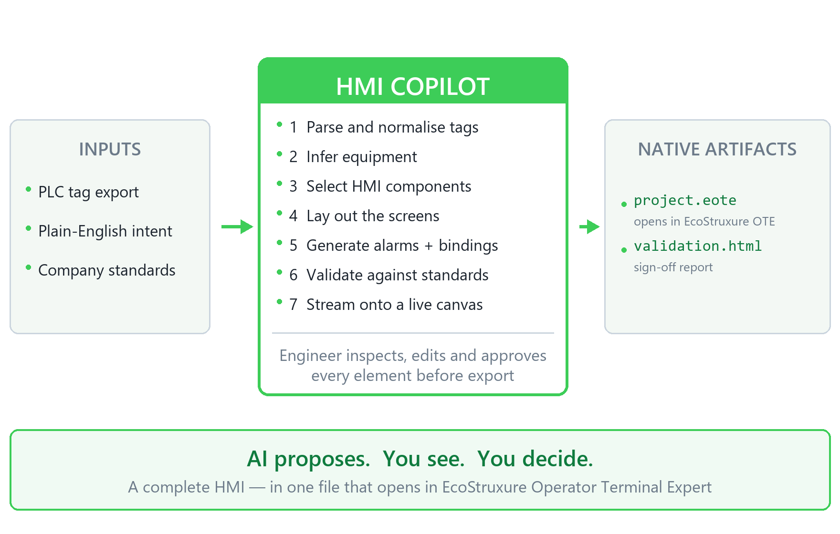
THE SOLUTION
A tag list in. A project file out.
HMI Copilot turns a PLC tag export plus plain-English intent into a complete, validated EcoStruxure project — and shows the engineer every object as it is generated.
1 file
opens with File ▸ Open Project. Nothing to import, nothing to assemble.
0 hand edits
screens, tags, alarms and bindings are all generated
Human-led
the engineer inspects, edits and approves every element before export
HMI Copilot
3
Notes:
The three figures on the right are the whole pitch. One file, zero hand edits, and a human still signs it off.

Slide 4
HOW IT WORKS
What happens between the two
1
Ingest
2
Infer equipment
Parse the PLC tag export — .csv, .xlsx or a Machine Expert symbol file — and normalise every tag to name, type, address and comment.
Cluster tags by naming pattern. PMP_101_RUN / _FLT / _SPD become one pump with a run state, a fault and a speed.
3
Select components
4
Lay out the screen
Pick the right part for each tag from the 50 types the product actually ships — real shapes, not invented ones.
Position parts absolutely inside a ViewBox sized to the target panel, respecting reading order and alarm-banner convention.
5
Generate alarms
6
Wire the bindings
Every pump gets its fault alarm, every level its Hi and HiHi. Missing ones are flagged, not silently skipped.
Build the Sources → Bindings → Targets graph: tags onto display properties, trigger tags onto alarms.
7
Validate
8
Package
Naming rules, binding integrity, type mismatches, completeness and standards conformance — before anything is exported.
Write Variables.db and Alarm.db, add the screen, emit Bindings.dat, repack as a native .eote.
HMI Copilot
4
Notes:
Steps 2 and 5 are where the senior engineer's judgement is encoded — knowing a pump needs a fault alarm is the expertise, not drawing the rectangle.

Slide 5
ARCHITECTURE
One repo, one language, one deploy
WEB CLIENT — Next.js App Router
Intent panel · Live HMI canvas (inline SVG) · Binding map · Validation · Build timeline
▼ SSE — one finished object at a time
ORCHESTRATOR — route handlers, Node runtime
Tag Ingestion → Equipment Inference → Layout Planner → Part Selector → Screen Generator → Binding Resolver → Validation Engine
▼ schema-grounded JSON
PACKAGER — jszip + sql.js
Screens\<guid>\Screen.dat · Variables.db · Alarm.db · Bindings.dat → project.eote
The packager runs on the Node runtime, not Edge — sql.js is WebAssembly, so there is no native module and it deploys anywhere. Most databases (Recipe, Security, Language) are copied verbatim from the shipped Blank.eote skeleton; only Variables.db and Alarm.db are written.
HMI Copilot
5
Notes:
If a judge asks 'why Next.js' — one language across client, orchestrator and packager, no CORS, no second dev server, and the packager is the only piece that needs a Node runtime.

Slide 6
THE INTERFACE IS THE PRODUCT
A chatbot is the wrong interface
Engineering trust is visual. An engineer will not accept a screen they did not see being built, and cannot sign off a binding they cannot inspect.
Streaming render
Timeline in engineering language
The binding map
Objects appear as their JSON completes. Never a spinner followed by a finished screen — the engineer watches the HMI assemble itself.
Not “Thinking…” but “Parsed 247 tags → detected 2 pumps → bound FT_101_PV → NumericDisplay.CurrentValue”. Every step clickable.
Tags left, object properties right, connectors between. Unbound tags amber, type mismatches red. Today this is invisible until commissioning.
Live simulation
Explain this object
Diff on change
Flip to Live and simulated values drive the canvas: lamps change state, numbers move, alarms fire — before any hardware exists.
Hover any element for why it exists: which tags produced it, which part type was chosen, which standard set its colour.
Ask for a change and the JSON diff appears beside an animated canvas transition. Nothing changes silently.
The preview renders the same Screen.dat that gets packaged. One model, two renderers — so the preview cannot lie about the output.
HMI Copilot
6
Notes:
This is the slide that separates us from a chatbot demo. Point at 'one model, two renderers' — the picture on screen is generated from the same JSON that goes into the file.

Slide 7
GROUNDED GENERATION
Why it cannot invent a screen that will not open
Machine-readable schemas
Real shapes, not guesses
The product's own palette
Buildtime/PropertyDefinitions/ defines every property of Screen, Variable, 25 parts and 13 layout objects. Generation is constrained by the .propDef, so an invented property is structurally impossible.
Every part shape and binding property name we emit was extracted from the sample projects the product ships. reference/part_examples.json records one real example of each of the 50 part types those projects use.
Screen colours are palette indices, not RGB. We resolve them from the product's own CommonScripts/Colors/Colors.lua — ColorSet 4, “Green-Simple” — so generated screens match the house style by construction.
A binding is declarative — this is the whole of “complex tag integration”:
{ "BindingText": "FT_101_PV.Value", "TargetProperty": "CurrentValue", "Target": 4 }
The engineer does this by hand, several hundred times, per project.
HMI Copilot
7
Notes:
The anti-hallucination slide. If a judge says 'LLMs make things up', this is the answer: the schema constrains the shape, the samples supply the vocabulary, and the validator catches the rest.

Slide 8
VALIDATION
Errors caught at the desk, not on site
Check | What it catches | Today
Naming conventions | Reserved words (BOOL, ACK, class…), leading digits, spaces, illegal characters | Silently dropped on import
Binding integrity | Unbound properties, tags bound to nothing, a REAL driving a BOOL lamp, bad scaling | Found at commissioning
Completeness | Equipment with no fault alarm, a trend with no logging, a screen with no navigation | Found by the customer
Standards conformance | Colour palette, font sizes, alarm-banner placement, resolution fit | Varies by engineer
Every finding is clickable back to the offending object, and the run produces a signed-off HTML report the customer's QA process can consume.
HMI Copilot
8
Notes:
Naming rules are taken verbatim from the product's own documented conventions — appendix/naming_conventions.htm. We did not invent a linter.

Slide 9
LIVE DEMO
The project we generated
Nothing here was drawn by hand. tools/make_project.py wrote the file; EcoStruxure Operator Terminal Expert opened it.
9

Slide 10
LIVE DEMO · THE ARTIFACT
What is about to be opened
demo_project/HMICopilot_PumpStation.eote — 25,053 bytes, generated in under a second.
19
7
5
11
0
parts placed on the screen
typed tags in Variables.db
alarms in Alarm.db
bindings wired
objects placed by hand
Object tree
AlarmSummary ×1 Lamp ×4 NumericDisplay ×2 Rectangle ×3 TextBox ×9
The one claim a mockup cannot make
This file was never saved by EcoStruxure. It was written from scratch by our packager — and it opens. That is the difference between a design tool and a generator.
HMI Copilot
10
Notes:
Say the byte count out loud — 25 KB. It is a small, legible, plain file, and that is exactly why full automation is possible.

Slide 11
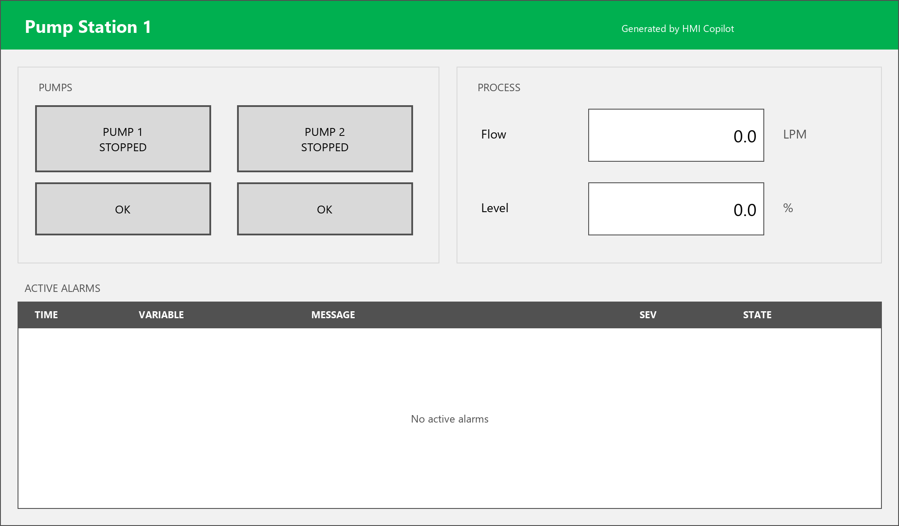
LIVE DEMO · STEP 1
Screen “PumpStation1”, as OTE opens it
Rendered from the project's own Screen.dat.
Banner, two status lamps and two fault lamps in a PUMPS panel, two numeric displays with units in a PROCESS panel, and an alarm summary across the bottom.
Every object is absolutely positioned inside a 1024 × 600 ViewBox — the same model the browser canvas uses, which is why the preview and the file can never disagree.
Colours are palette indices into ColorSet 4, so the screen already matches the project's house style.
HMI Copilot
11
Notes:
This image is not a screenshot and not a mockup — it is our renderer walking the Screen.dat inside the .eote. Then switch to OTE and show the real thing beside it.

Slide 12
LIVE DEMO · STEP 2
Tags and alarms, already configured
Variables.db — 7 tags
Alarm.db — 5 alarms
Name | Type | Comment
PMP_101_RUN | BOOL | Pump 1 running
PMP_101_FLT | BOOL | Pump 1 fault
PMP_102_RUN | BOOL | Pump 2 running
PMP_102_FLT | BOOL | Pump 2 fault
FT_101_PV | REAL | Flow, LPM
LT_101_PV | REAL | Tank level, percent
LT_101_HI | BOOL | Tank high level
Message | Kind | Level | Setpoint | Sev
Pump 1 fault | bit | HiHi | — | 5
Pump 2 fault | bit | HiHi | — | 5
Tank high level | bit | HiHi | — | 3
Tank level high | level | Hi | 85 | 3
Tank level critically high | level | HiHi | 95 | 5
Open the Variables editor and the Alarm editor in OTE — this is what is in them. Nobody typed any of it. Two of the five alarms are level alarms with real setpoints, inferred from the tag being a tank level.
HMI Copilot
12
Notes:
Show the Variables editor and the Alarm editor in the real tool here. The level alarms are the interesting ones: the setpoints came from inference, not from the tag list.

Slide 13
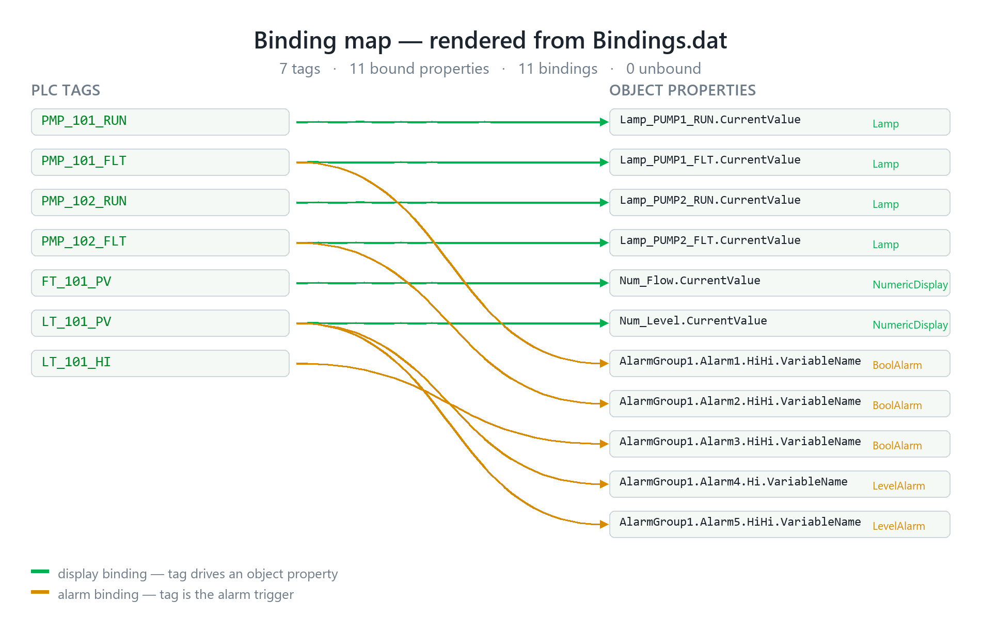
LIVE DEMO · STEP 3
Every tag wired to the object it drives
This is the pain point, made visible.
11 bindings from 7 tags — 6 driving display properties, 5 driving alarm triggers.
Drawn from the real Sources → Bindings → Targets graph in Bindings.dat, not from a diagram we authored.
Note LT_101_PV drives three things at once: the level display, a Hi alarm and a HiHi alarm. Getting that wrong by hand is a commissioning bug.
In the product, unbound tags glow amber and type mismatches red.
HMI Copilot
13
Notes:
In OTE: click Lamp_PUMP1_RUN and show CurrentValue is already bound to PMP_101_RUN. That single click is the proof.

Slide 14
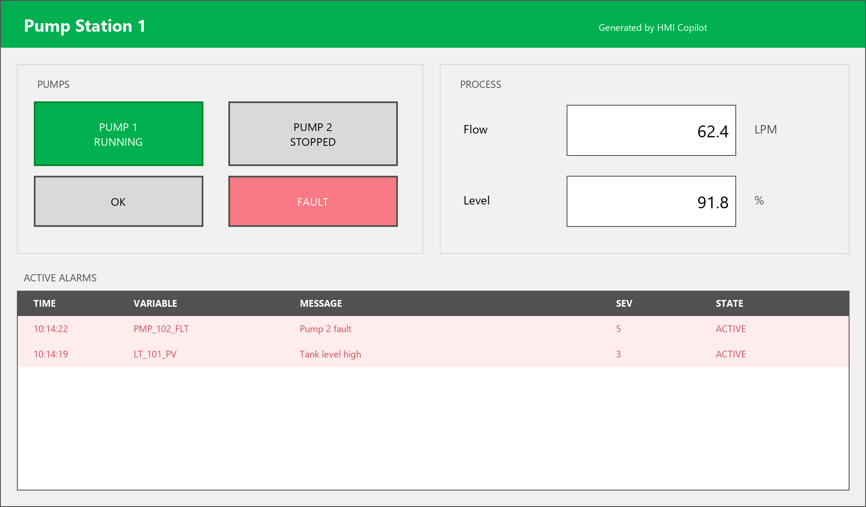
LIVE DEMO · STEP 4
The same screen, driven by values
Behaviour validated before hardware exists.
Pump 1 runs, pump 2 faults, flow and level move, and the two alarms whose conditions are met appear in the summary.
The lamp swap is not an animation we drew — Lamp objects carry an Off and an On state in the JSON, and the bound tag chooses between them. The renderer just reads the value.
Values here come from the simulator. The same path accepts Modbus or OPC-UA.
HMI Copilot
14
Notes:
Be precise if asked: the simulator is what drives this. Modbus/OPC-UA is designed and the seam is there, but we are not claiming it is wired up today.

Slide 15
LIVE DEMO · THE SCRIPT
Run it yourself in ninety seconds
On the machine
Inside EcoStruxure
1
python tools/make_project.py demo_project
5
Screens ▸ PumpStation1 — the laid-out screen
2
Fresh GUIDs, fresh file — nothing cached.
6
Variables — seven typed tags with comments
3
HMICopilot_PumpStation.eote
7
Alarms — five alarms, two with setpoints
4
Double-click it, or File ▸ Open Project inside OTE.
8
Click Lamp_PUMP1_RUN → CurrentValue is already bound to PMP_101_RUN
If a part ever misbehaves, the fallback is already built.
HMICopilot_Minimal.eote is the same layout using only TextBox and Rectangle. If it opens and the full one does not, the project skeleton is proven correct and only a part needs adjusting — so the demo degrades instead of dying.
HMI Copilot
15
Notes:
Rehearse the fallback. If PumpStation misbehaves on the judges' machine, open Minimal, say exactly what it isolates, and carry on. Never debug live.

Slide 16
HOW IT IS POSSIBLE
The project format is legible
Established from the templates the product itself ships at Buildtime\BuildtimeData\ProjectTemplates — no binary reverse-engineering, no licence bypass.
16

Slide 17
THE FORMAT
Inside a .eote
Plain JSON and plain SQLite
<project>.eote ZIP (entries use BACKSLASH separators) ├─ Project.dat, Target.dat JSON identity, panel model, resolution ├─ Variables.db SQLite the tags ├─ Alarm.db SQLite alarm groups and alarms ├─ Recipe.db, Security.db … SQLite other subsystems ├─ Bindings.dat JSON Sources → Bindings → Targets ├─ Screens\Hierarchy.dat JSON screen order └─ Screens\<guid>\Screen.dat JSON the object tree
Screen.dat is a tree of Type / Children / Location / Width / Height. It generates and diffs like any other document.
No signature, no encryption
Every project carries _metadata with EncryptionInfo: null and SignatureInfo: null.
Bindings are declarative
Tag to property is one JSON object. Alarms bind the same way, through VariableName.
One trap worth knowing
ZIP entry names must use backslash separators, the way the product writes them. Python's zipfile normalises them to forward slashes on construction — the filename has to be assigned afterwards, and verified against the raw bytes.
The geometry maps onto the browser
Absolute Location plus Width/Height inside a ViewBox is a direct match for absolutely-positioned SVG.
HMI Copilot
17
Notes:
If asked how long this took: the format was readable in an afternoon because it is JSON and SQLite. The backslash detail was the only real trap.

Slide 18
INTEGRATION
We meet the product at the artifact boundary
EcoStruxure Operator Terminal Expert is a hybrid stack — a .NET/C# Buildtime shell with native Qt5/C++ modules, and a pure C++/Qt5 runtime with embedded Lua. We do not merge into that codebase, by design.
HMI Copilot
→
project.eote
→
EcoStruxure OTE
Next.js / TypeScript
files — language-agnostic
C# / C++ / Qt / Lua
Tier | Mechanism | Status
0 — Artifact (this project) | Generate the .eote; the engineer opens it | Working today. Zero coupling, no licence dependency
1 — Lua scripting | Both layers embed Lua — the product's own sanctioned extension point | Available, the natural next step
2 — Managed plugin | Buildtime is .NET, so the generator can be repackaged as an in-process C# library | Needs Schneider's SDK and signing — the productization path
Both layers already ship Qt5WebEngine, and the parts library already includes a WebBrowser object — so this same interface can later be docked inside the engineering tool with no new technology decision.
HMI Copilot
18
Notes:
The likely challenge is 'why not build it into the product'. Answer: that needs an SDK we do not have and code signing, and it would break on every release. The file boundary works with any OTE 4.4+ install and survives upgrades.

Slide 19
IMPACT
What changes on a real project
 | Today | With HMI Copilot
First screen for a new equipment type | Hours to days | Minutes
Binding ~250 tags | Manual, error-prone | Generated, verified, visualised
Errors found | At commissioning, on site | At design time, in the browser
New-engineer ramp-up | Months of shadowing | Guided from day one, every decision explained
Consistency across engineers | Varies by author | Enforced by shared standards
This does not replace the HMI engineer.
It encodes the senior engineer's judgement — which part to use, which alarm every pump needs, which naming standard applies — and makes it available to everyone on the team, every time.
HMI Copilot
19
Notes:
Land the last line. Judges from an engineering company do not want to hear that their engineers are being replaced.

Slide 20
SCOPE
What is built, and what is designed
Working today
• The .eote generator — screens, tags, alarms and bindings, packaged and opening in OTE
• Format and schema extraction from the shipped installation
• Screen.dat → pixels renderer, the same model the canvas uses
• Binding-map rendering from the real graph
• The compound-object packager, as a secondary output
Designed, not yet built
• The streaming web canvas — the architecture and the render model are settled; the UI is not finished
• Live Modbus / OPC-UA — the simulator drives the canvas today
• Multi-screen projects with navigation between them
• Customer standards packs
Deliberately out of scope: device driver configuration, PLC logic, panel download and safety-instrumented functions. Generated variables are internal, which keeps the demo hardware-free.
HMI Copilot
20
Notes:
Volunteer this slide before a judge finds it. Being straight about the amber column buys credibility for everything in the green one.

Slide 21
STACK
Technology and tools
Frontend
Intelligence
Artifacts
Target
Next.js (App Router)
React · TypeScript
Inline SVG canvas
Zustand + immer
SSE for streaming
Claude — claude-opus-5
@anthropic-ai/sdk
messages.parse() with
zodOutputFormat
Schema-grounded output
jszip — the ZIP container
sql.js — SQLite in WASM
SheetJS — tag ingestion
Node runtime, not Edge
JSON + SQLite output
EcoStruxure OTE 4.4
PropertyDefinitions schemas
50 shipped part types
ColorSet 4 palette
Modbus / OPC-UA (sim)
Nothing in the artifact path needs a native module: sql.js is WebAssembly and jszip is pure JavaScript, so the packager that writes a real EcoStruxure project runs anywhere Node runs — including serverless.
HMI Copilot
21
Notes:
If asked why SQLite and not a hosted database: these are not our databases. Variables.db and Alarm.db are the product's own file formats, sitting inside the .eote. Supabase would be storing our application data — a different question, and not what the judges are asking about.

Slide 22
WHAT HAPPENS NEXT
Standards packs
a customer loads their own library and naming rules, and the Copilot generates in their house style
Brownfield mode
ingest an existing project, report standards drift, propose fixes
Machine Expert round-trip
regenerate screens when the PLC symbols change
Commissioning assistant
replay logged values through the live canvas to reproduce field issues at a desk
AI proposes. You see. You decide.
A complete HMI — in one file that opens in EcoStruxure Operator Terminal Expert.
<Team name>
Notes:
Close on the three-word line, then go straight to questions. Do not read the roadmap aloud — it is there for the judges to read while you answer.

